Slide 1
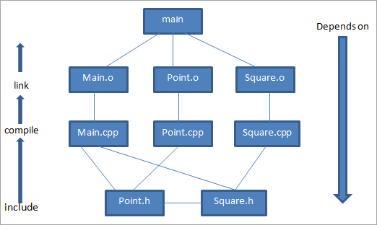
Makefile
Main.cpp: Main driver program
Point.h: Header file for point class
Point.cpp: CPP implementation file for point class
Square.h: Header file for square class
Square.cpp: CPP implementation file for square class
With the above-given .cpp and .h files, we need to compile these files separately to generate .o files and then link them into executable named main.
So next we compile these files separately.
g++ -c main.cpp: generates main.o
g++ -c point.cpp: generates a point.o
g++ -c square.cpp: generates square.o
Next, we link the object files together to generate the executable main.
g++ -o main main.o point.o square.o
dependency chart

Slide 2
Makefile
The entire makefile for this example will look as shown below:
# *****************************************************
# Variables to control Makefile operation
CC = g++
CFLAGS = -Wall -g
# ****************************************************
# Targets needed to bring the executable up to date
main: main.o Point.o Square.o
$(CC) $(CFLAGS) -o main main.o Point.o Square.o
# The main.o target can be written more simply
main.o: main.cpp Point.h Square.h
$(CC) $(CFLAGS) -c main.cpp
Point.o: Point.cpp Point.h
$(CC) $(CFLAGS) -c Point.cpp Point.h
Square.o: Square.cpp Square.h Point.h
$(CC) $(CFLAGS) -c Square.cpp Square.h Point.h
dependency chart

Slide 3
Makefile
Defining Rules
Rules follow the syntax below: (Note that commands following a rule are indented by a tab)
targets: prerequisites
<commands>
output: source.cpp
g++ source.cpp -o output
Variables in Makefiles
CXXFLAGS = -g -Wall
FILENAME=source
CC = g++
And so on….
output:${FILENAME}.cpp
CC ${FILENAME}.cpp CXXFLAGS –o output
g++ source.cpp –g –Wall –o output

Slide 4
Makefile (contd…)
Automatic variables used by make utility
targets: prerequisites
<commands>
output: source.cpp
g++ source.cpp -o output
Alternatively the above line(s) can be re-written as follows:
CXXFLAGS = -g -Wall
FILENAME=source
CC = g++
And so on….
output:${FILENAME}.cpp
CC $< CXXFLAGS –o $@
targets has a pre-defined variable name $@
Prerequisites has a pre-defined variable name $<
g++ source.cpp –g –Wall –o output

Slide 5
Makefile (contd…)
foo.o: foo.cpp
CC -c $< -c $@
bar.o: bar.cpp
CC -c $< -c $@
However, as the targets share the same suffix, the above two rules can now be substituted by the following pattern rule:
%.o: %.cpp
CC -c $< -c $@
In addition other optional rules can be created, for eg:
To create and assembly listing by the name name ‘foo.s’ from file ‘foo.cpp’
foo.s:foo.cpp
CC –S $<
To create and assembly listing by the name name ‘foo.s’ from file ‘foo.cpp’, and the output shall be re-directed to an file by name ‘foo.pre’
foo.pre:foo.cpp
CC –E foo.cpp > foo.pre

Slide 6
Makefile (contd…)
#custom make file
FILE=second_file
all:EXE OBJ ASM PRE
EXE:${FILE}.o
g++ ${FILE}.o -o myapp
OBJ:${FILE}.cpp
g++ -c ${FILE}.cpp
CLEAN:
del *.exe
del *.o
del *.s
del *.pre
ASM:${FILE}.cpp
g++ -S -O1 ${FILE}.cpp
PRE:${FILE}.cpp
g++ -E ${FILE}.cpp > ${FILE}.pre

Slide 7
For more on automatic variable names, refer the foll: link for more details
Makefile automatic variable names

